Slide 1

Data Mining & Business Intelligence Car Sales Analysis

Slide 2
Agenda
Introduction
Problem Statement
Dataset and Algorithm
Mining Algorithm Implementation
Cluster Formation
Power BI Visuals
Results
Dashboard Live Recording
Questions

Slide 3
Problem Statements
Mining Aspect: Analyzing car sales data presents a multifaceted challenge, primarily in extracting actionable insights crucial for informed decision-making. The complexity lies in deciphering patterns, trends, and customer behaviors from a vast pool of transactional data. This involves identifying significant factors influencing sales performance, understanding customer preferences, and pinpointing areas for improvement across various dimensions such as geographical regions, dealership performance, and product offerings.
Visualization Aspect: Effective visualization techniques play a pivotal role in transforming raw data into comprehensible insights. As the volume and complexity of data increase, the need for clear, intuitive visual representations becomes paramount. Visualization facilitates the communication of findings to stakeholders, enabling them to grasp insights quickly and make informed decisions. From interactive dashboards to insightful charts and graphs, visualization techniques serve as a bridge between data analysis and actionable insights.

Slide 4
Dataset And Algorithm
Dataset Description: The car sales dataset comprises transactional records capturing essential attributes related to each sale. These attributes include customer demographics, dealership details, car specifications, pricing information, and regional data. The dataset provides a comprehensive overview of sales activities over a specified period, allowing for in-depth analysis of various factors influencing car sales. The Dataset that we picked consists of 23,907 records and 16 attributes. We got the dataset from reputable open-source website i.e, topmate.io.
Mining Algorithm: For analyzing the dataset, we employed K-means clustering, a popular unsupervised learning algorithm. K-means clustering is used to partition the dataset into distinct groups (clusters) based on similarity, with the number of clusters predefined. Prior to clustering, preprocessing techniques were applied to the dataset, including standardization of numerical features and one-hot encoding of categorical variables. These preprocessing steps ensure the data is appropriately formatted and scaled for clustering analysis.

Slide 5
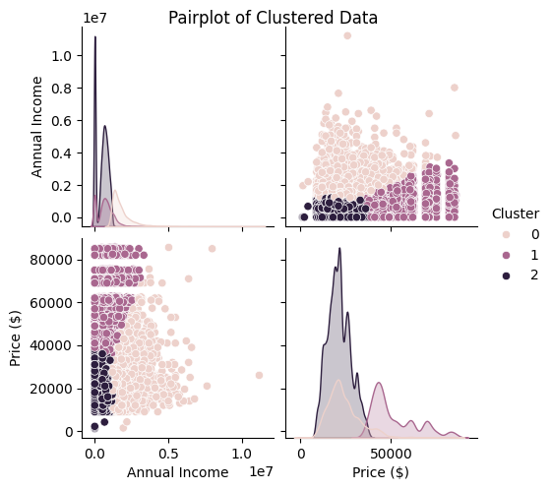
Mining Algorithm Implementation
Preprocessing Steps: The preprocessing steps involved in preparing the car sales dataset for clustering primarily focused on data cleaning and transformation to ensure optimal performance of the K-means algorithm. These steps include:
Handling missing values: Identifying and either removing or imputing missing values in the dataset to maintain data integrity.
Encoding categorical variables: Converting categorical variables such as gender, dealer name, company, model, engine, transmission, color, body style, and dealer region into numerical format using one-hot encoding.
Standardizing numerical variables: Scaling numerical variables like annual income and price to a standard scale to avoid biases during clustering.

Slide 6
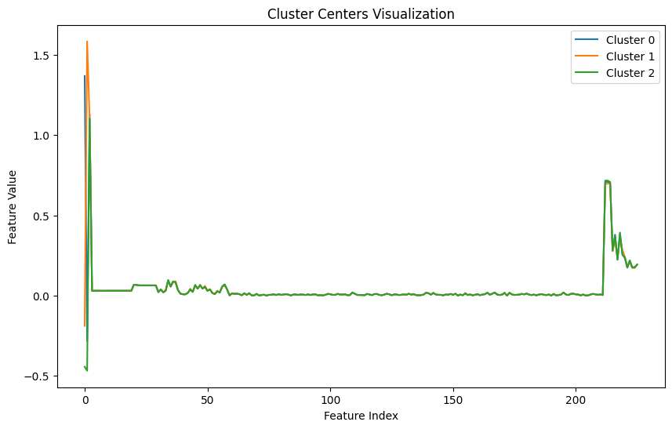
Mining Algorithm Implementation
Algorithm Implementation: The K-means clustering algorithm was implemented to partition the preprocessed dataset into 'k' clusters. Key parameters and settings include:
Number of clusters (k): This parameter determines the number of clusters into which the dataset is divided. In our implementation, 'k' was set based on domain knowledge and through techniques such as the elbow method.
Initialization method: The algorithm's performance can vary based on how initial cluster centroids are selected. Common initialization methods include 'random' and 'k-means++'.
Convergence criteria: The algorithm iteratively assigns data points to the nearest cluster centroid and updates the centroids until convergence. Convergence is typically defined by a tolerance or maximum number of iterations.

Slide 7
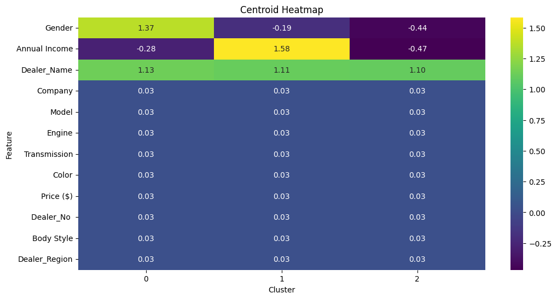
Mining Algorithm Implementation
Validation and Performance Evaluation: The Silhouette Score is a metric used to evaluate the performance of the clustering algorithm. It measures the cohesion and separation of clusters, with values ranging from -1 to 1. A higher Silhouette Score indicates better-defined clusters:
The Silhouette Score of 0.0997 suggests that the clustering model exhibits moderate cohesion and separation among clusters. While positive, the score indicates that there is still room for improvement in cluster distinctiveness and coherence.
This evaluation metric helps assess the effectiveness of the clustering algorithm in creating meaningful and distinct clusters from the car sales dataset.

Slide 8
Cluster Formation
In the context of the car sales dataset with attributes such as gender, annual income, dealer name, company, model, engine, transmission, color, price, dealer region, and body style, the clusters generated by the K-means algorithm represent distinct groups of car sales based on similarities in these attributes.
Cluster 0 - Premium Segment Buyers:
This cluster likely includes customers with higher annual incomes purchasing luxury or premium cars.
Characteristics may include high-priced cars from prestigious companies, possibly with specific color preferences and advanced engine features.
Dealerships associated with this cluster may be located in affluent regions or cater to a more upscale clientele.
Cluster 1 - Economy Segment Buyers:
Customers in this cluster may have moderate to lower annual incomes and are inclined towards more budget-friendly car options.
Cars in this cluster may belong to popular companies offering economical models with standard features.
Dealerships associated with this cluster may serve diverse regions, including both urban and suburban areas.
Cluster 3 - Performance Segment Buyers:
This cluster could represent customers interested in high-performance vehicles, regardless of price.
Characteristics may include sports cars or vehicles with powerful engines and unique transmission types.
Dealerships in this cluster might focus on specific regions known for enthusiasts or have a niche market for performance cars.

Slide 9

Power BI Visualizations
Dataset Import: The car sales dataset was imported into Power BI using the data import functionality. This process involves connecting Power BI to the dataset file, selecting the appropriate data source, and importing the dataset into Power BI's data model.
Preprocessing: Additional preprocessing steps were performed within Power BI using Power Query. These steps may include cleaning data, handling missing values, transforming data types, and filtering out irrelevant or redundant columns. Power Query provides a user-friendly interface for data preparation tasks, ensuring that the dataset is optimized for visualization and analysis.
DAX Queries: DAX (Data Analysis Expressions) queries were utilized for data manipulation and calculation within Power BI. DAX functions enable users to create calculated columns, measures, and tables based on the dataset's attributes. These queries can perform complex calculations, aggregations, and comparisons, enhancing the analytical capabilities of the Power BI dashboard.

Slide 10
Power BI Visualizations
Visualization Techniques: The Power BI dashboard incorporates various visualization techniques to effectively convey insights from the car sales data:
Scatter Plots: Used to visualize relationships between two numerical variables, such as annual income and price, allowing for analysis of trends or patterns.
Cards: Display key performance indicators (KPIs) such as total sales, average price, or cars sold, providing a quick summary of important metrics.
Donut Charts: Illustrate the distribution of categorical variables, such as sales by body style or color, highlighting the relative proportions of each category.
Maps: Show geographic distribution of sales, allowing for spatial analysis and identification of regional sales trends.
Matrices: Provide a structured view of data, enabling comparison and analysis of sales across multiple dimensions, such as time periods or product categories.
These visualization techniques help stakeholders visually interpret the car sales data, identify trends, patterns, and outliers, and make data-driven decisions.

Slide 11
Result Interpretation
Insights Derived: The Power BI dashboard yielded valuable insights from the car sales data, including:
Regional Sales Disparities: Variations in sales performance across different regions, indicating potential opportunities for targeted marketing strategies.
Product Performance Trends: Changes in sales trends for different product categories, highlighting shifts in consumer preferences and the need for product diversification.

Slide 12
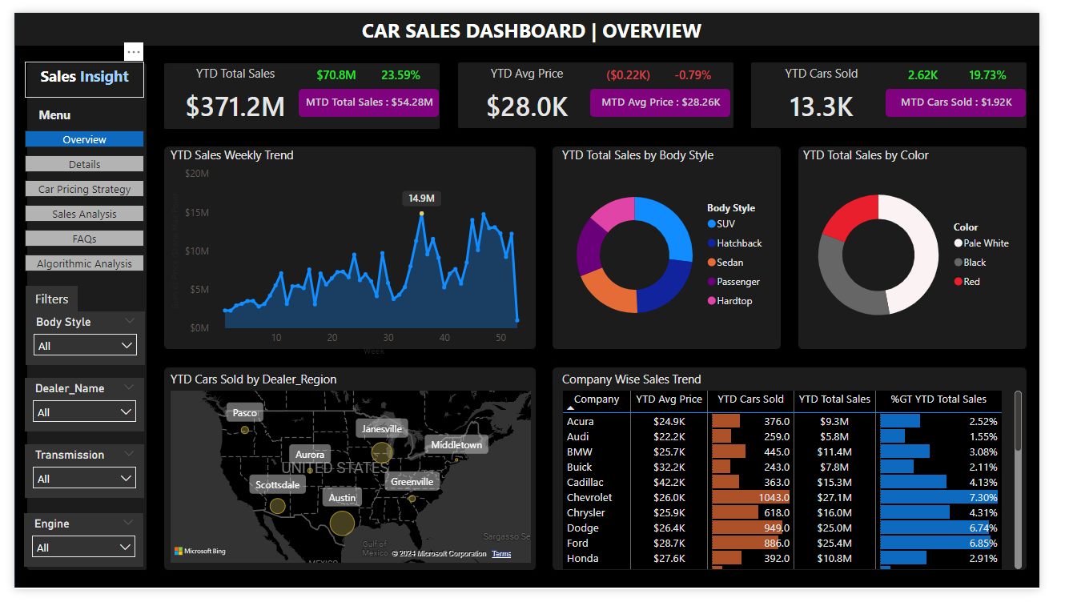
Result Interpretation

Slide 13
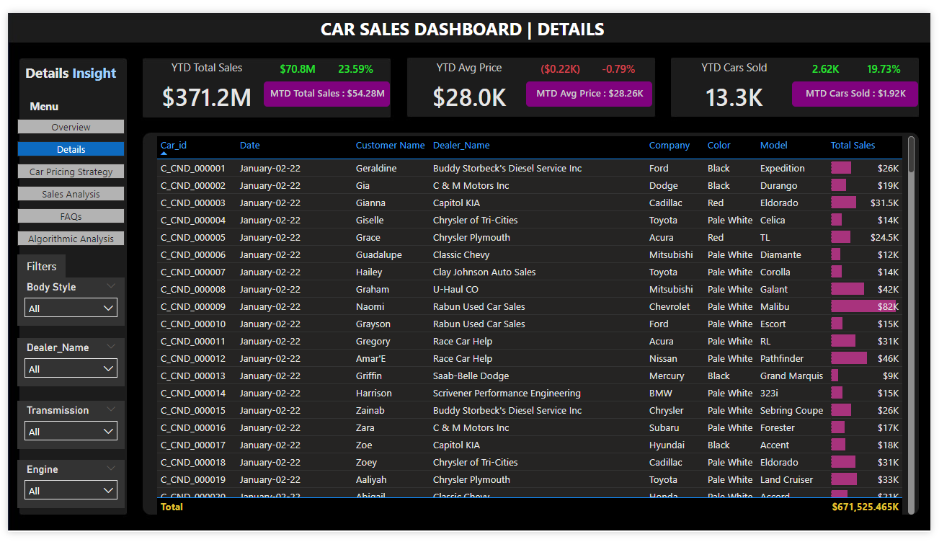
Result Interpretation

Slide 14
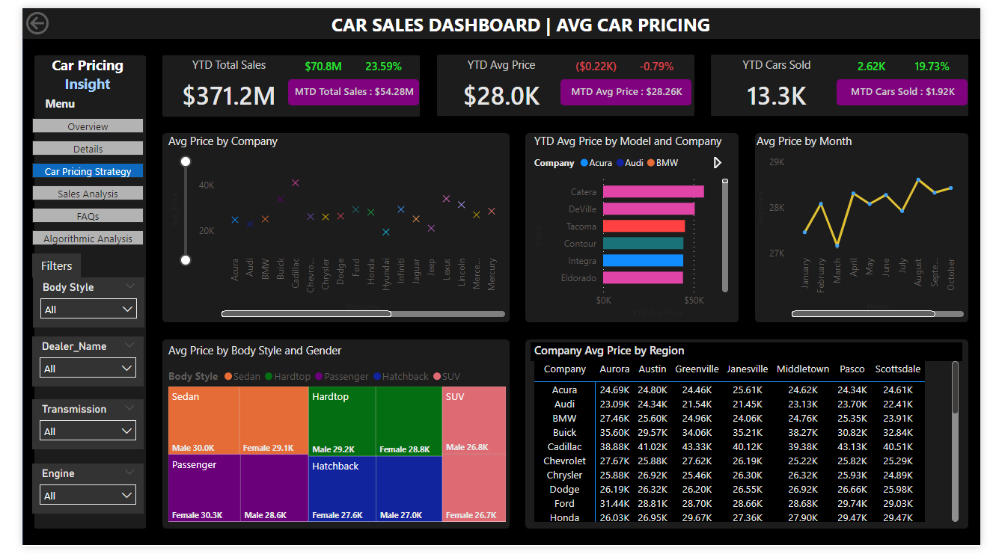
Result Interpretation

Slide 15
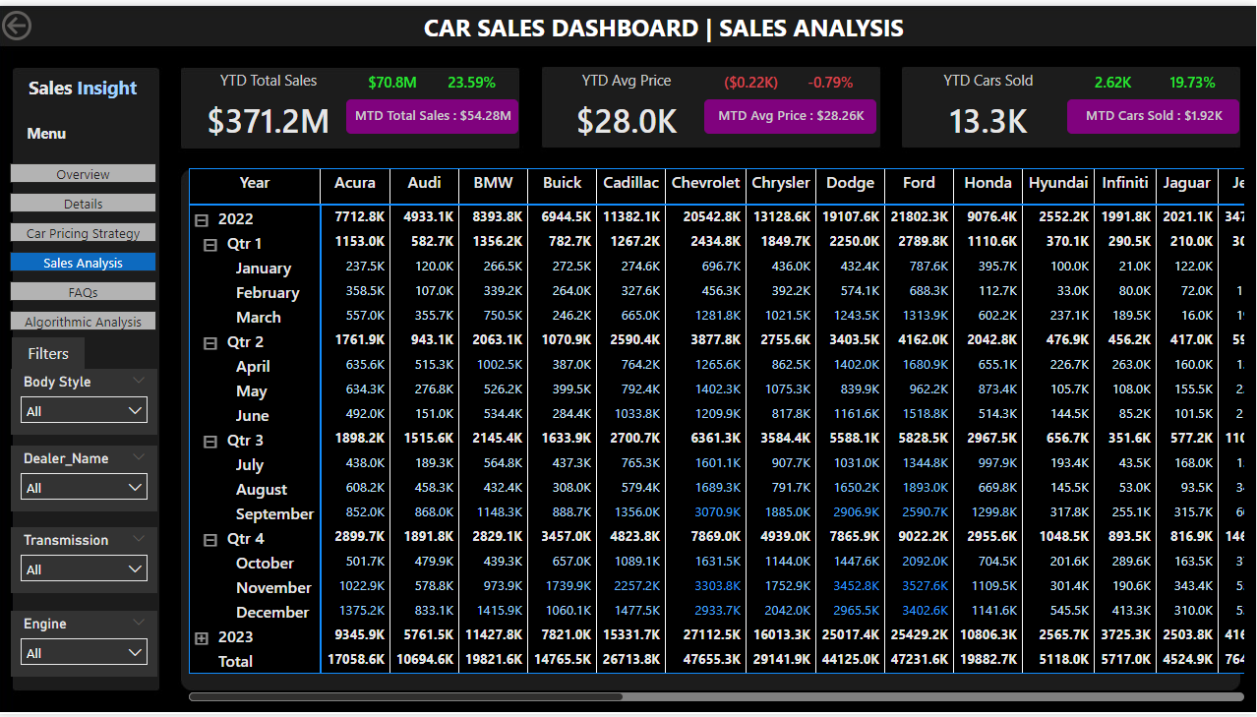
Result Interpretation

Slide 16
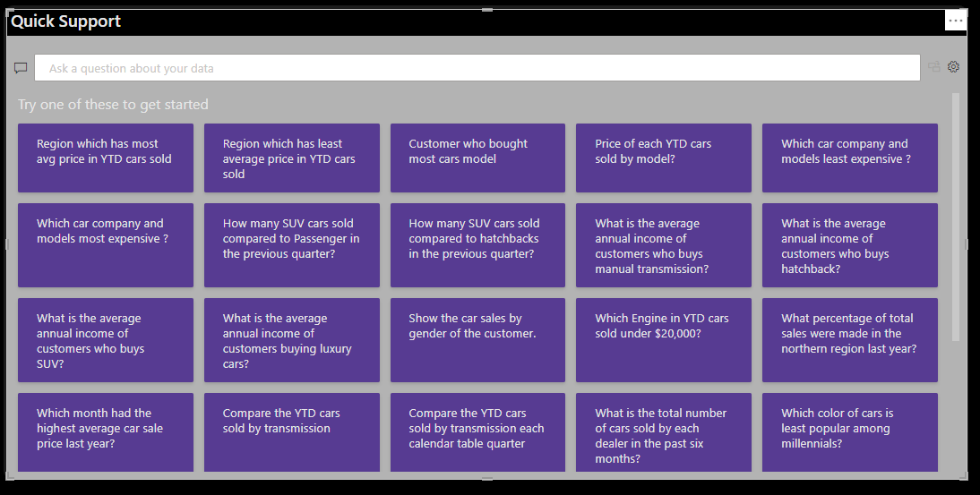
Result Interpretation

Slide 17
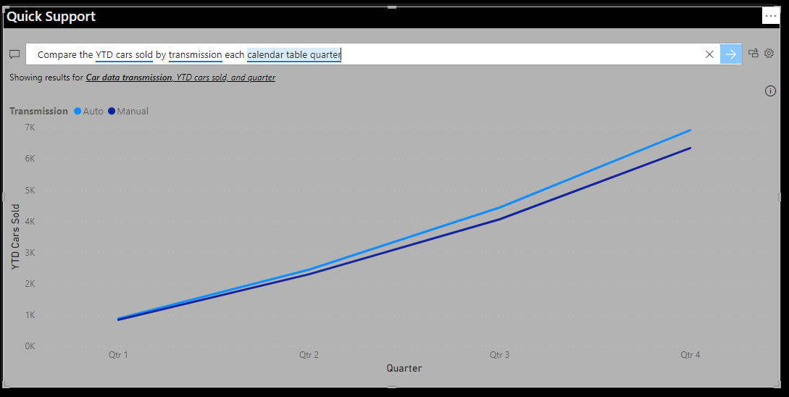
Result Interpretation

Slide 18
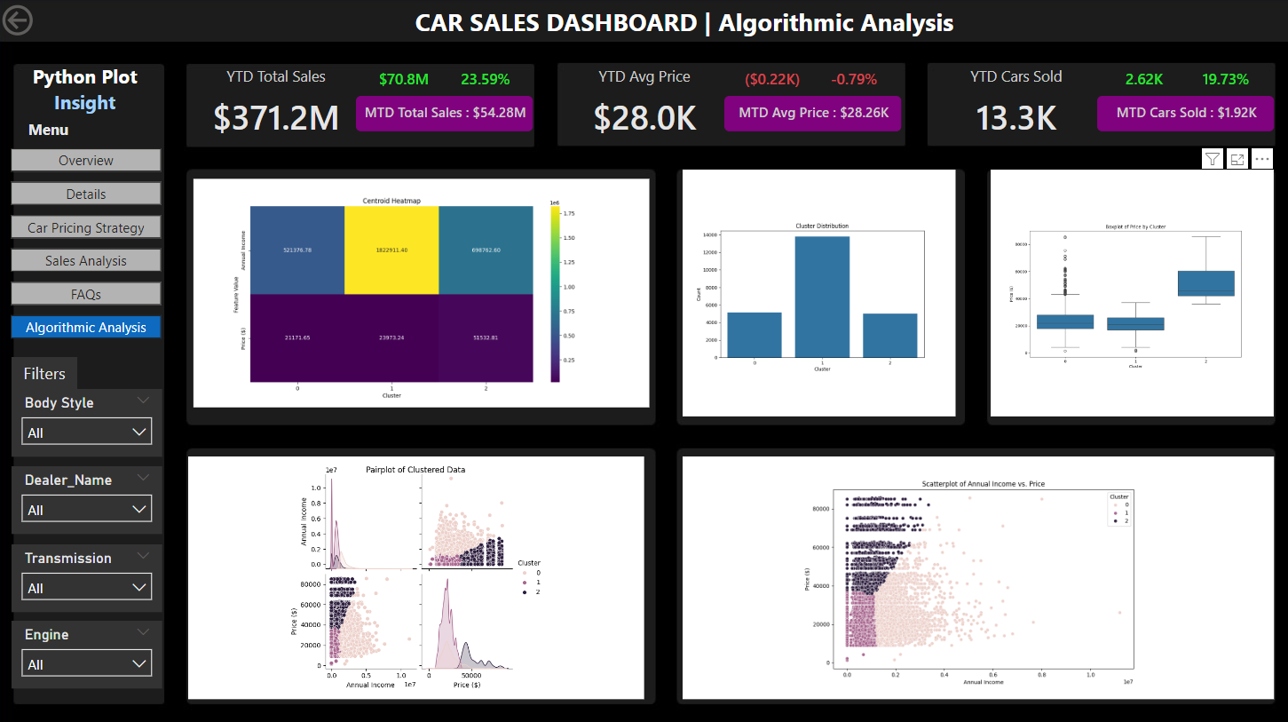
Result Interpretation

Slide 19
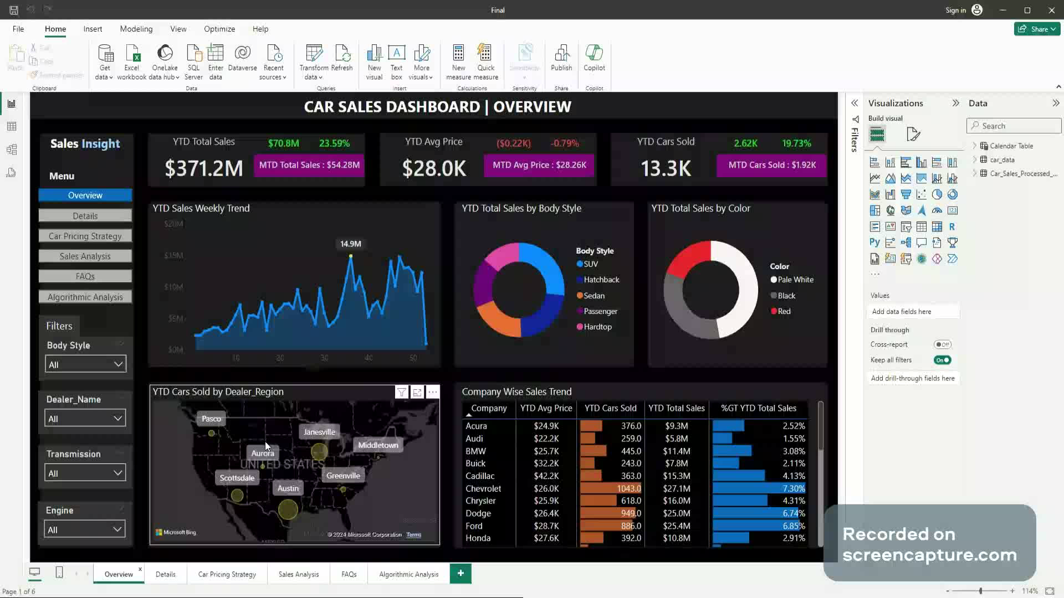
Dashboard Recording

Slide 20

Questions?

